Slide 1
Azure Container Apps with .NET
Anthony Chu – Product Manager

Slide 2

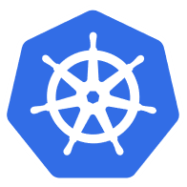



Azure Container Apps
Generally Available
Serverless containers for microservices
Build modern apps on open source
Focus on apps, not infrastructure
Scale dynamically based on events
Kubernetes
KEDA
Dapr
Envoy

Slide 3
What can you build with Azure Container Apps?
API endpoints
Web
Apps
Event-driven processing
Background processing
Microservices
MICROSERVICE A
MICROSERVICE B
HTTP TRAFFIC
MICROSERVICE C
80%
20%
REVISION 1
REVISION 2
Microservices architecture with the option to integrate with Dapr
E.g., API app with HTTP requests split between two revisions of the app
E.g., Web app with custom domain, TLS certificates, and integrated authentication
E.g., Queue reader app that processes messages as they arrive in a queue
E.g., Continuously running background process transforms data in a database
AUTO-SCALE CRITERIA
Individual microservices can
scale independently using any KEDA scale triggers
Scaling is determined by the number of concurrent HTTP requests
Scaling is determined by the number of concurrent HTTP requests
Scaling is determined by the number of messages in the queue
Scaling is determined by the level of CPU or memory load

Slide 4
Environment (virtual network boundary)
Container app 1
Azure Container Apps
Revision 1
Revision 2
Replica
Replica
Replica
Replica
Overview — concepts and terminology
Container(s)
Container(s)
Container(s)
Container(s)
Container app 2
Revision 1
Revision 2
Replica
Replica
Container(s)
Container(s)

Slide 5
Environment (virtual network boundary)
Environments
Environments define an isolation and observability boundary around a collection of container apps deployed in the same virtual network

Slide 6
Environment (virtual network boundary)
Container app 1
Container apps
Individual apps or microservices
Container app 2

Slide 7
Environment (virtual network boundary)
Container app 1
Revisions
Revision 1
Revision 2
Revisions are immutable version snapshots of a container app
Container app 2
Revision 1
Revision 2

Slide 8
Environment (virtual network boundary)
Container app 1
Replicas
Revision 1
Revision 2
Replica
Replica
Replica
Replica
Instances of a revisions that are created or removed based on scaling rules
Container app 2
Revision 1
Revision 2
Replica
Replica

Slide 9
Environment (virtual network boundary)
Container app 1
Containers
Revision 1
Revision 2
Replica
Replica
Replica
Replica
Containers in Azure Container Apps can use any and development stack of your choice
Container(s)
Container(s)
Container(s)
Container(s)
Container app 2
Revision 1
Revision 2
Replica
Replica
Container(s)
Container(s)

Slide 10

Environment (virtual network boundary)
Container app 1
Ingress
Revision 1
Revision 2
Replica
Replica
Replica
Replica
Internal or external visibility with TLS termination and support for HTTP/1.1 and HTTP/2. Also supports TCP.
Container(s)
Container(s)
Container(s)
Container(s)
80%
20%
Ingress

Slide 11
Demo

Slide 12

Serverless microservices: Contoso Retail
Azure Service Bus Topic
Order Service
Loyalty Service
Azure Cosmos DB
Azure Cosmos DB
Order UI
Container Apps Environment
End user

Slide 13





Application autoscaling made simple Open-source, extensible, and vendor agnostic
Metrics Adapter | Controller | Scaler
Intelligently scale your event-driven applications
Out-of-the-box scalers for various vendors, databases, messaging systems, telemetry systems, CI/CD, and more
Event-driven
Built-in scalers
Kubernetes-based Event Driven Autoscaler
Support for triggers across variety of cloud providers & products
Bring rich scaling to every workload
Vendor-agnostic
Rich capabilities
Drive the scaling of any container based on a growing list of 35+ event sources, known as: scalers
keda.sh

Slide 14
Serverless microservices: Contoso Retail
Azure Service Bus Topic
Order Service
Loyalty Service
Azure Cosmos DB
Azure Cosmos DB
Order UI
Container Apps Environment
End user

Slide 15
Serverless microservices: Contoso Retail
Azure Service Bus Topic
Order Service
Loyalty Service
Azure Cosmos DB
Azure Cosmos DB
Order UI
Container Apps Environment
End user

Slide 16






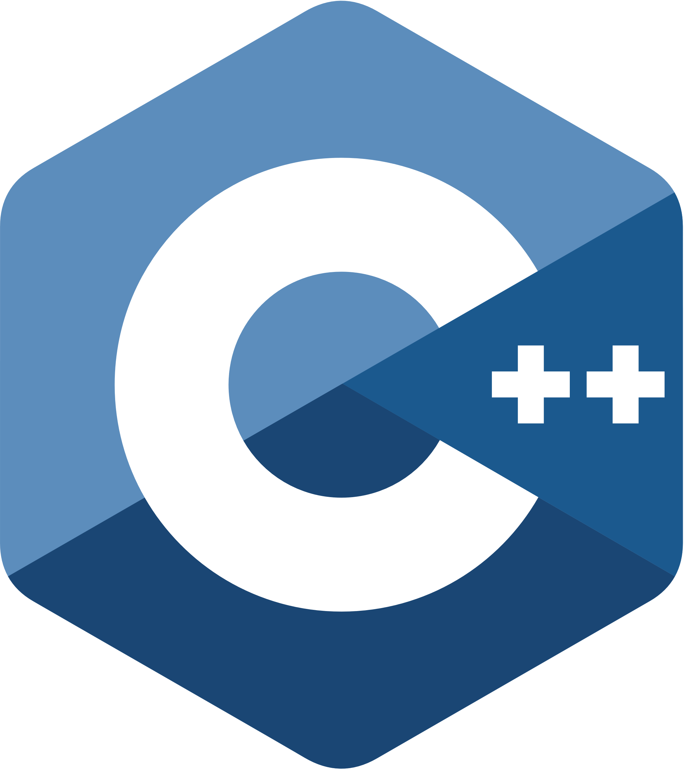








Microservices using any language or framework Any cloud or edge infrastructure
Microsoft services written in any code or framework
Distributed Application Runtime
HTTP API
gRPC API
Service-to-service invocation
State management
Publish and subscribe
Resource bindings and triggers
Actors
Observability
Secrets
Extensible
Portable, event-driven, runtime for building distributed applications across cloud and edge
Hosting infrastructure
dapr.io
Azure Arc
On-premises

Slide 17
Serverless microservices: Contoso Retail
Azure Service Bus Topic
Order Service
Loyalty Service
Azure Cosmos DB
Dapr API
Dapr API
Azure Cosmos DB
Order UI
Dapr API
Container Apps Environment
End user

Slide 18
Demo

Slide 19
Try Azure Container Apps
https://aka.ms/containerapps

